Slide 1

Advanced Algorithms #2
Radix Sort
Start at 17:30 For technical problems please write in the Q&A section

Slide 2




Who I am?
Andrea Angella
Co-Founder of DotNetToscana
Software Engineer in Red Gate Software (UK)
Microsoft C# Specialist
Passion for algorithms
www.andreaangella.com
angella.andrea@gmail.com

Slide 3



Why learning algorithms?
To solve problems
To solve complex problems
To solve problems on big data sets
To become a better developer
To find a job in top software companies
To challenge yourself and the community
Lifelong investment
It is fun!

Slide 4


Why this series?
Practical (real problems and solutions)
Pragmatic (no mathematical proofs)
Algorithms are written from scratch in C#

Slide 5
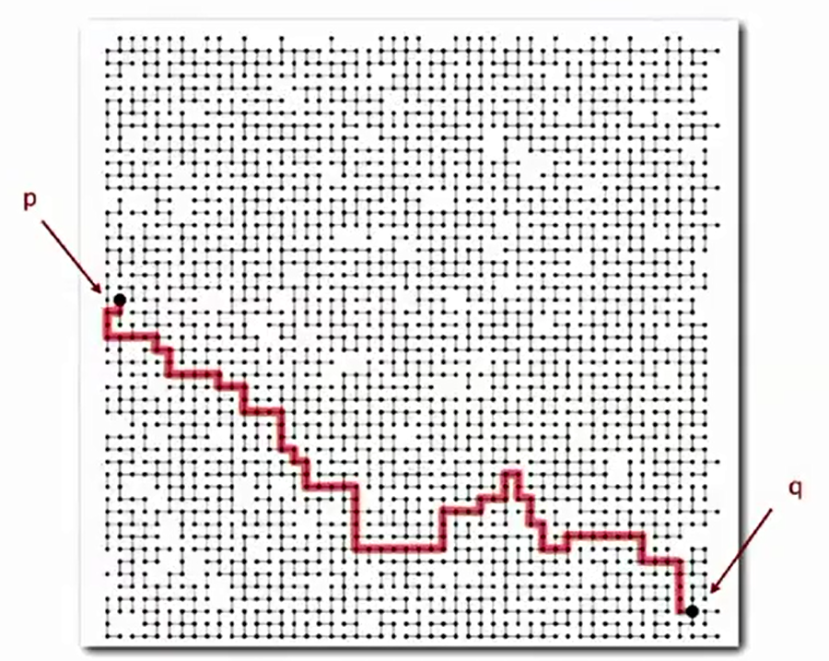


Previous Webcasts
#1 Union/Find on Disjoint-Set Data Structures
http://bit.ly/1jwO4gx

Slide 6

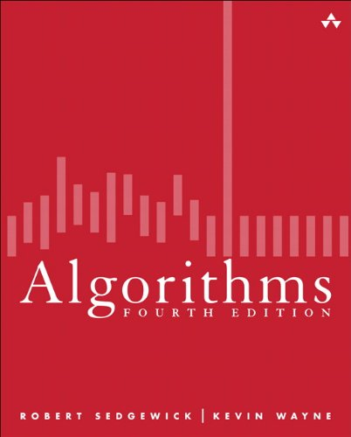

Credits
Robert Sedgewick and Kevin Wayne
Algorithms 4 Edition
http://algs4.cs.princeton.edu/code/
Coursera:
https://www.coursera.org/course/algs4partI
https://www.coursera.org/course/algs4partII

Slide 7

Agenda
Counting Sort
Stable Sorting
Index Counting Sort
LSD Radix Sort

Slide 8
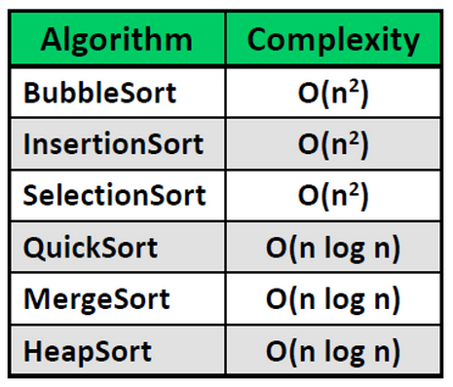
Comparison Sort
A comparison sort is a type of sorting algorithm that only reads the list elements through a single abstract comparison operation (often a "less than" operator) that determines which of two elements should occur first in the final sorted list.
http://en.wikipedia.org/wiki/Comparison_sort
Ω (N Log N)

Slide 9
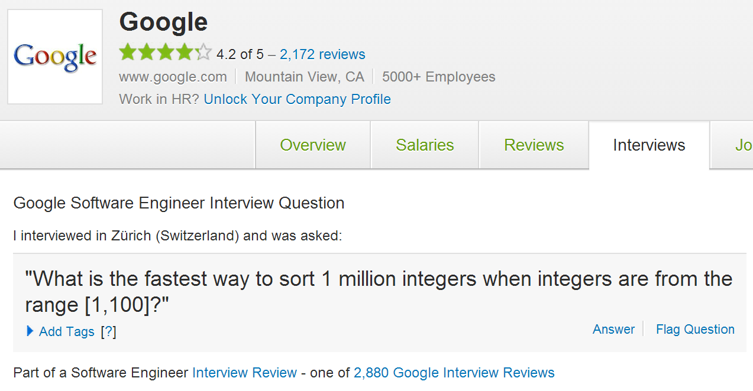
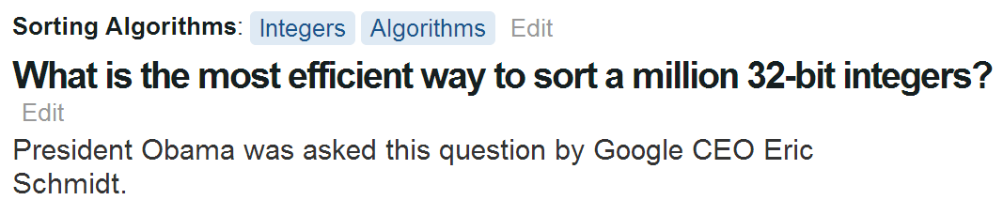

Slide 10
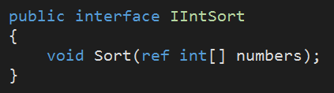
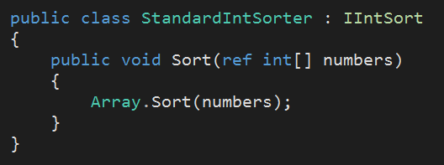
Can we beat the standard sort?

Slide 11
Counting Sort
0
1
2
3
4
5
6
7
array[]
1
0
2
2
1
1
2
2
0
1
2
1
3
4
Max = 2
count[]
0
1
2
3
4
5
6
7
array[]
0
1
1
1
2
2
2
2

Slide 12
CODE

Slide 13
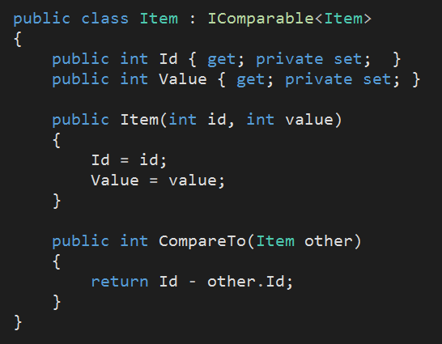
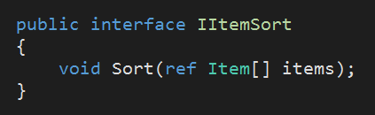
What about ordering items by Id?

Slide 14
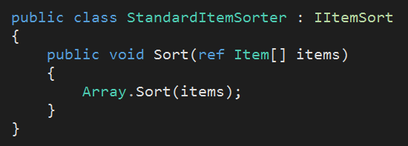
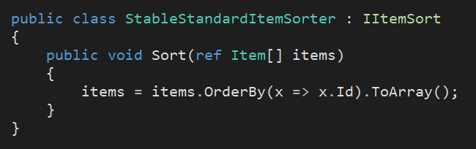
And stability?

Slide 15
CODE

Slide 16
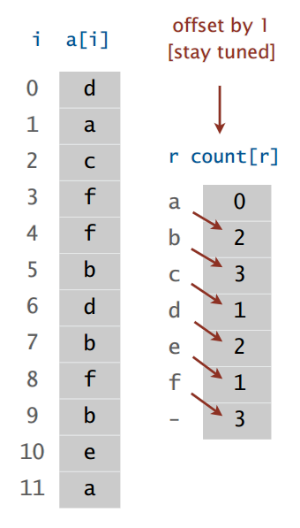
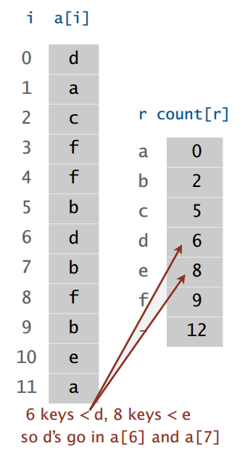
Index Counting Sort
1°
2°

Slide 17
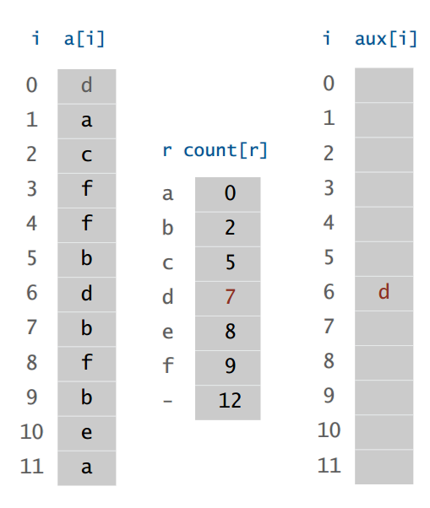
Index Counting Sort
2°
3°

Slide 18
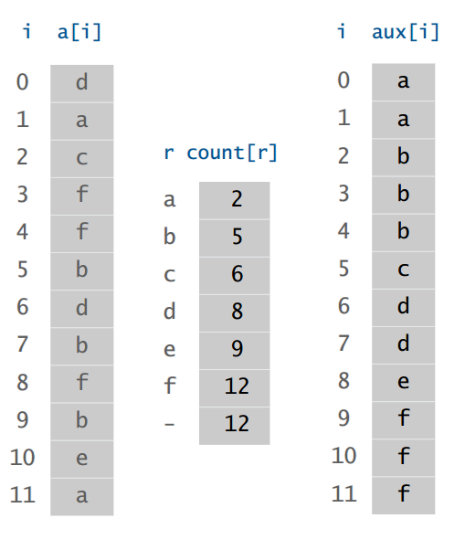
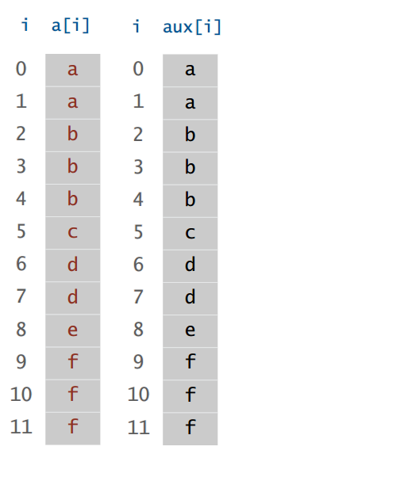
Index Counting Sort
3°
4°

Slide 19
CODE

Slide 20
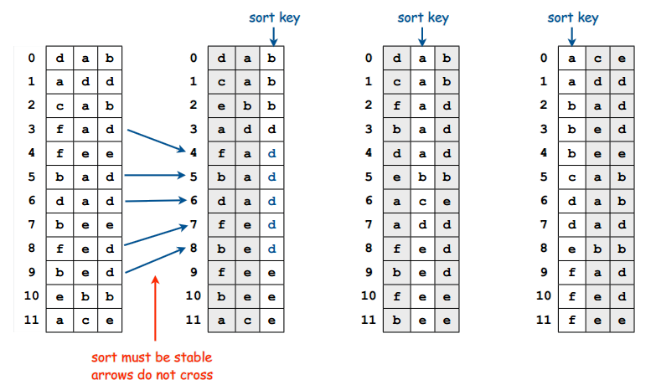
LSD Radix Sort
Use Index Counting Sort multiple times!

Slide 21
CODE

Slide 22
Important Lessons
O(N Log N) is not the best complexity for sorting (only for comparison sorting)
You can develop stable in-place sorting algorithms with linear complexity.
Counting Sort is the fastest way to sort a million integers in the range [1, 100]
Index Counting Sort is great to sort items indexed by integer ID (in small range)
Radix Sort is the most efficient way to sort a million 32-bit integers
O(N Log N) is not necessarily slower than O(N) in practice
Comparison Sorts are the most flexible (you can order on any type)

Slide 23
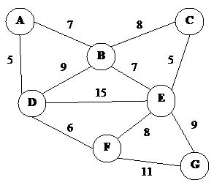
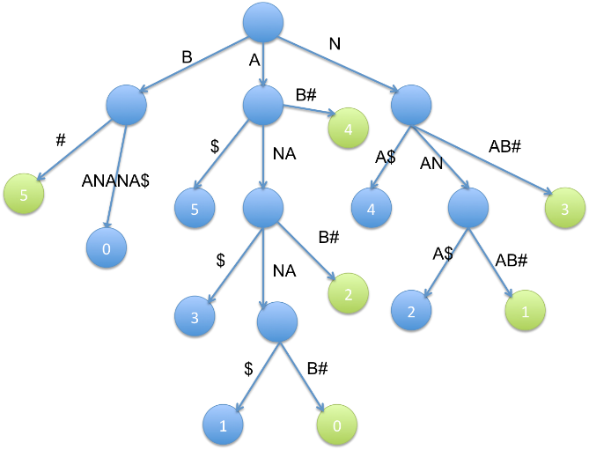
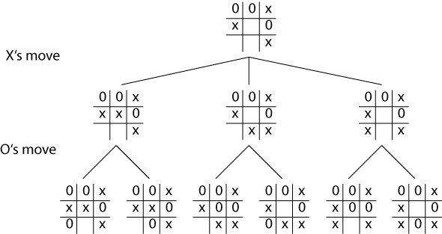
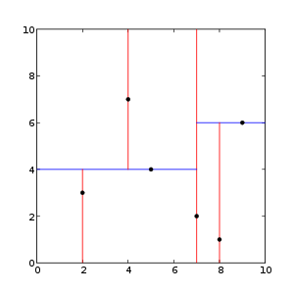
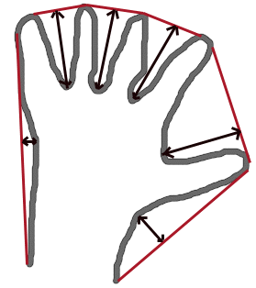
Don’t miss the next webcasts
Graph Search (DFS/BFS)
Suffix Array and Suffix Trees
Kd-Trees
Minimax
Convex Hull
Max Flow
Combinatorial
Dynamic Programming
…

Slide 24
Thank you
https://github.com/angellaa/AdvancedAlgorithms

